Slide 1


Project: Deforestation (Fire classification )
Name : Sumit Sahu
Student ID : STU6825b67befad21747302011
AICTET ID : INTERNSHIP_1748923002683e727a876ea

Slide 2

Learning Objectives
Learn to preprocess and analyze satellite or aerial imagery for fire detection.
Extract key features (e.g., vegetation index, thermal bands) to identify fire- affected areas.
Apply machine learning or deep learning models to classify fire vs. non-fire zones.
Evaluate model performance using metrics like accuracy, precision, and recall.
Develop skills to build automated tools for monitoring and managing forest fires.
Understand the environmental causes and impacts of deforestation-related fires.
GOAL
Source :
www.freepik.com/

Slide 3
Tools and Technology used :
Programming Languages
Python
R
Vsc
2. Remote Sensing & Satellite Data Sources
MODIS (NASA)
Landsat
Sentinel-2 (ESA)
3. Software and Libraries
QGIS / ArcGIS
OpenCV
scikit-learn
4. Visualization & Analysis
Pandas / NumPy

Slide 4
Methodology :
1. Data Collection
2. Preprocessing Images
3. Feature Extraction
4. Classification with ML
5. Evaluation
6. Visualization

Slide 5
.
.
Problem Statement:
Manual fire monitoring is inefficient and lacks real-time precision.
Forest are burning due to both natural causes and human activities like illegal logging .
These fires are hard to track quickly , especially in remotes areas .
Satellite images it gives helpful data but need is not system to analyze them.
Challenge: scale, terrain, and inaccessible data
.

Slide 6
Solution:
- Automated classification
- Satellite image processing
- Pattern recognition via ML
- Quick visual feedback

Slide 7
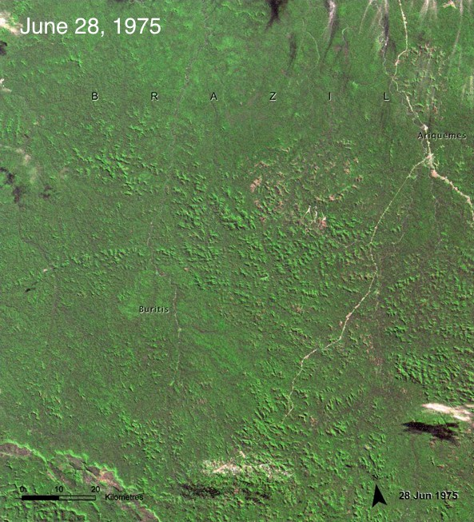
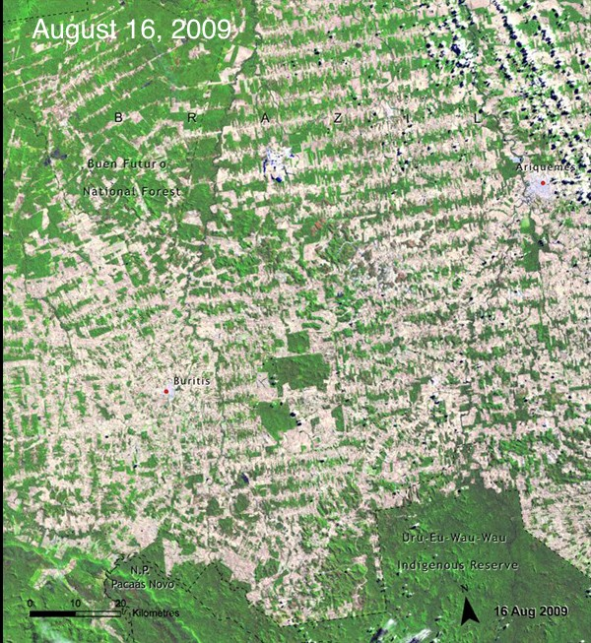
Screenshot of Output:
Before Deforestation After Deforestation

Slide 8
latitude longitude brightness ... bright_t31 frp type
count 2.000000 2.000000 2.000000 ... 2.000000 2.000000 2.000000
mean 25.938600 91.696700 308.800000 ... 297.550000 9.750000 1.000000
std 3.055691 7.497595 8.202439 … 7.000357 1.6 26346 1.414214
min 23.777900 86.395100 303.000000 ... 292.600000 8 .600000 0.000000
25% 24.858250 89.045900 305.900000 ... 295.075000 9.175000 0.500000
50% 25.938600 91.696700 308.800000 ... 297.550000 9.750000 1.000000
75% 27.018950 94.347500 311.700000 ... 300.025000 10.325000 1.500000
max 28.099300 96.998300 314.600000 ... 302.500000 10.900000 2.000000

Slide 9
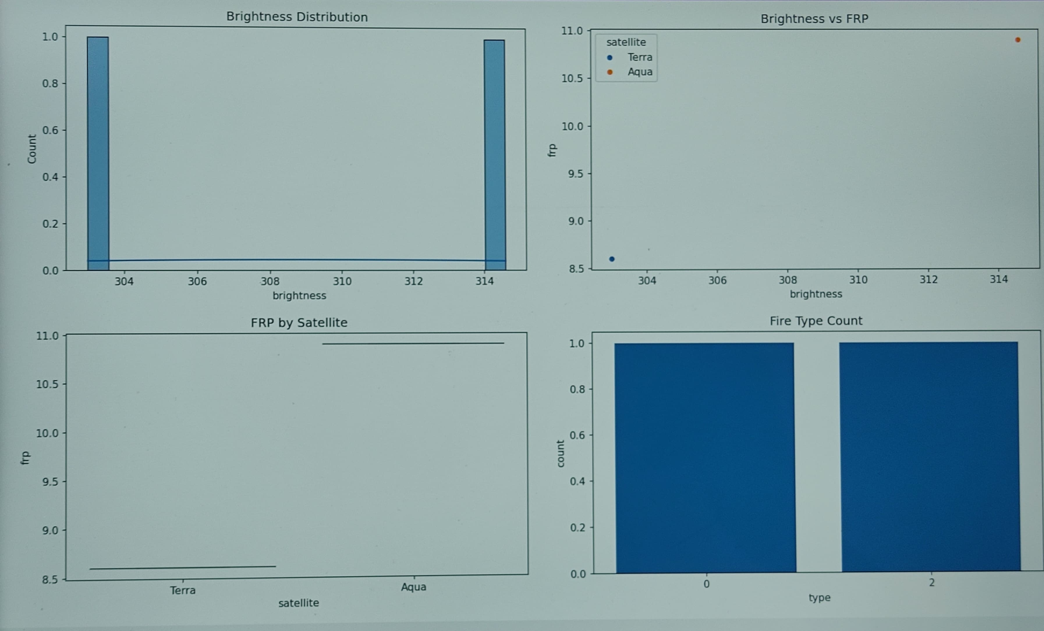

Slide 10
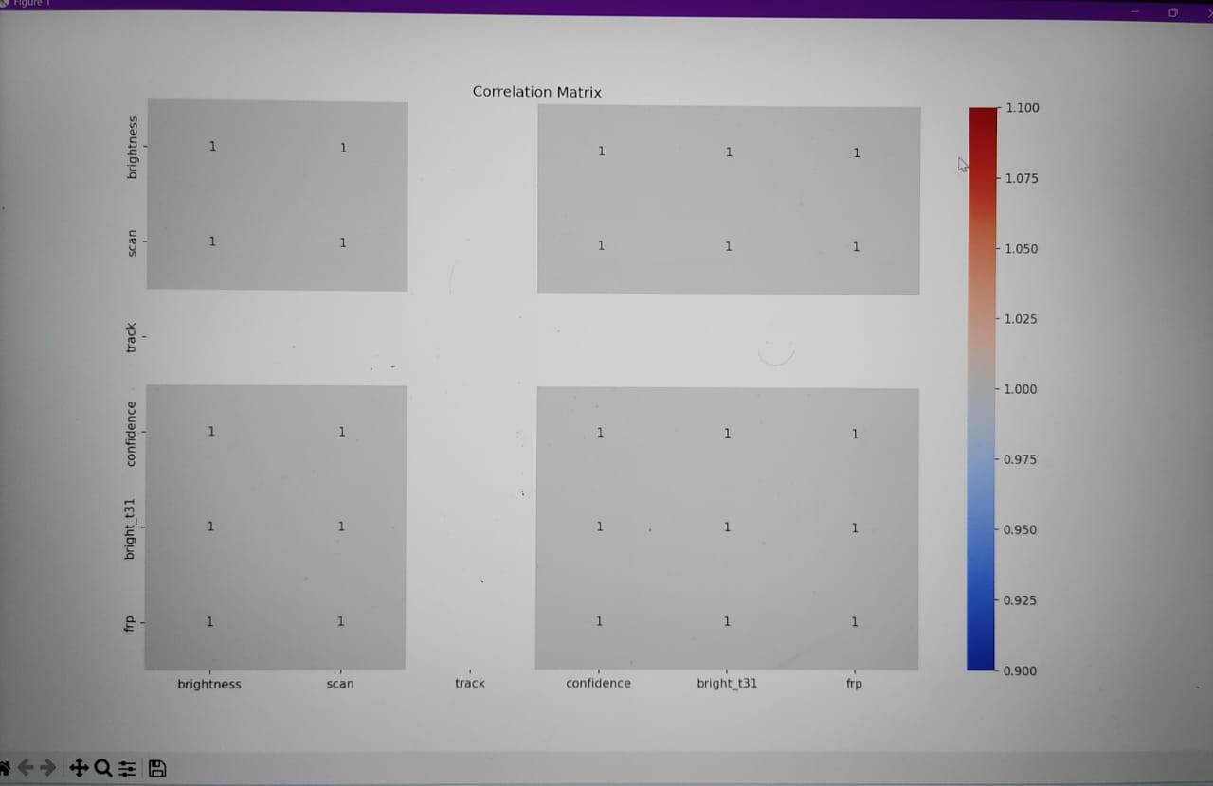

Slide 11
Conclusion:
- ML models detect fire zones effectively
- Enhances environmental monitoring
- Scalable tech solution
- Future: real-time alerts and drones

